Slide 1
Explainable Multi-Agent System for Early Detection of Medication Non-Adherence
An explainable multi-agent AI system that combines a PDC-based ML model with LLM agents to detect early medication non-adherence and predict patient risk for proactive intervention.

Slide 2
Name of the team: CARE3AI
Details of Team members
TEAM MEMBER NAME | Recent Passport Photo | Email ID | Phone number [WhatsApp]
Sandeepa N R |  | Sandeepanr.mca25@bmsce.ac.in | 6362030415
Shrilaxmi H |  | Srilaxmi.mca25@bmsce.ac.in | 9945411015
Tanish g |  | tanishg.mca25@bmsce.ac.in | 7019173230

Slide 3
Problem statement
The Challenge
Medication of non-adherence is a major challenge in chronic disease management, often leading to poor health outcomes and increased hospitalizations. Healthcare providers lack continuous visibility in patient medication adherence patterns. There is a need for an assistive AI system that can analyze adherence data and identify patients at risk of non-compliance.
Medication Data Analysis Agent
An agent that analyzes medication intake logs, refill history, and missed-dose patterns.
Adherence Risk Detection Agent
An agent that identifies declining adherence trends using historical patterns and predefined rules.
Reminder & Lifestyle Support Assistant
An agent that generates adherence to reminders and educational insights
(assistive only, non-diagnostic).
Outcome
Improves medication adherence to awareness and supports better long-term treatment outcomes.

Slide 4
Proposed solution
Medication Data Analysis Agent: Ingests CSV logs and refills history to calculate real-time Proportion of Days Covered (PDC).
Adherence Risk Detection Agent: Employs Group-Based Trajectory Modeling (GBTM) to classify patients into "risk tiers" (e.g., Gradual Decline vs. Rapid Decline).
Reminder & Lifestyle Support Assistant: An Agentic RAG system that delivers personalized "Behavioral Tailoring" advice grounded in WHO and NICE clinical guidelines.

Slide 5
Need of project
Early identification of patients at risk of non-adherence
Behavior-aware risk stratification instead of binary adherence checks
Clinically grounded, explainable AI outputs
Scalable multi-agent architecture aligned with real healthcare workflows

Slide 6
End user of project
Patients with Chronic Conditions
  Individuals managing long-term medications (e.g., diabetes, hypertension)
  Receive personalized reminders and adherence support
Caregivers / Family Members
  Monitor adherence risk alerts for elderly or dependent patients
  Support timely medication intake
Healthcare Providers (Doctors, Nurses, Pharmacists)
  View adherence risk levels and behavioral trends
  Enable early, non-diagnostic intervention
Healthcare Organizations & Hospitals
  Reduce readmissions caused by non-adherence
  Improve population-level medication compliance
Public Health & Research Teams
  Analyze adherence patterns at scale
  Support evidence-based healthcare planning

Slide 7
Technology Used
Langflow platform
IBM Grainte model (ibm-granite-3-2-8b)
IBM Cloud
RAG
IBM Watsonx.ai
Watsonx

Slide 8
Real-World Use Case Scenario
Example: Patient Journey
Patient starts medication
Slight adherence drop detected
Risk agent flags early warning
Reminder agent generates advice
Email agent notifies patient
Patient resumes routine

Slide 9
Novelty and Uniqueness
Uses trajectory-based adherence modeling to capture long-term behavioral patterns rather than isolated events
Enables true multi-agent collaboration, where specialized agents detect, reason, and act in coordination
Predicts adherence risk proactively, identifying failure signals before missed doses occur
RAG-backed decision-making ensures hallucination-free outputs, grounded in clinical and policy guidelines
Built-in email intervention engine automatically delivers risk-aware, personalized alerts to patients and caregivers — bridging AI insights with real-world action

Slide 10
Multi-Agent Workflow Design
  The system must implement the three mandatory agents defined in the problem statement 3:
  Medication Data Analysis Agent: A custom Python node in LangFlow that ingests CSV medication logs (e.g., from IoT-based datasets on Kaggle) and calculates the Proportion of Days Covered (PDC):
  Adherence Risk Detection Agent: Utilizing Granite 8B Instruct, this agent classifies patient behavior into risk tiers based on trajectory modeling research. It identifies subtle patterns of decline before a patient misses their first refill.
  Reminder & Lifestyle Support Assistant: An agentic RAG system that retrieves evidence-based advice from a vector store containing WHO and NICE medication adherence guidelines.
  Email notification Agent: Automatically sends adherence alert, Delivers reminders via email, Ensures timely patient communication

Slide 11
Langflow component Used
ChatInput – Takes the user’s chat message as input to the flow.
​
IBMwatsonxModel – Calls an IBM watsonx LLM to generate a text response from the input message.
​
Agent – Orchestrates tool use and reasoning over messages and tools to produce a final agentic response.
​
Prompt Template – Formats and structures messages (e.g., injecting the agent’s output) into a prompt for the next agent.
​
File – Provides file content as a message input into the flow.
​
SplitText – Splits file or message content into chunks for downstream processing.

Slide 12
Components used as Tools
Python Interpreter Component – Exposes a Python execution environment as a tool that the agent can call, used to calculate pdc_score as well as adherence_risk classification.
​​
Adherence Prediction Component – Used API Request component which will send HTTP request to the deployed ML model which predicts the adherence_status of Patient.
Mail Sending Component– Used API Request component which will send mails for the patients with proper WHO guidelines message along with their risk level.

Slide 13
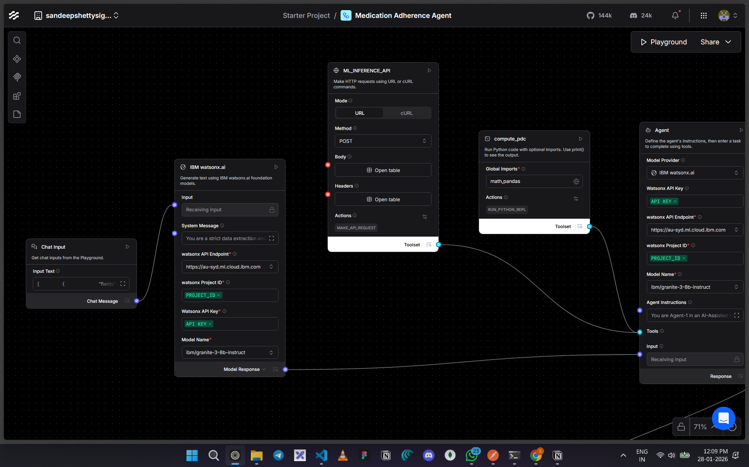
Input Screenshot 1

Slide 14
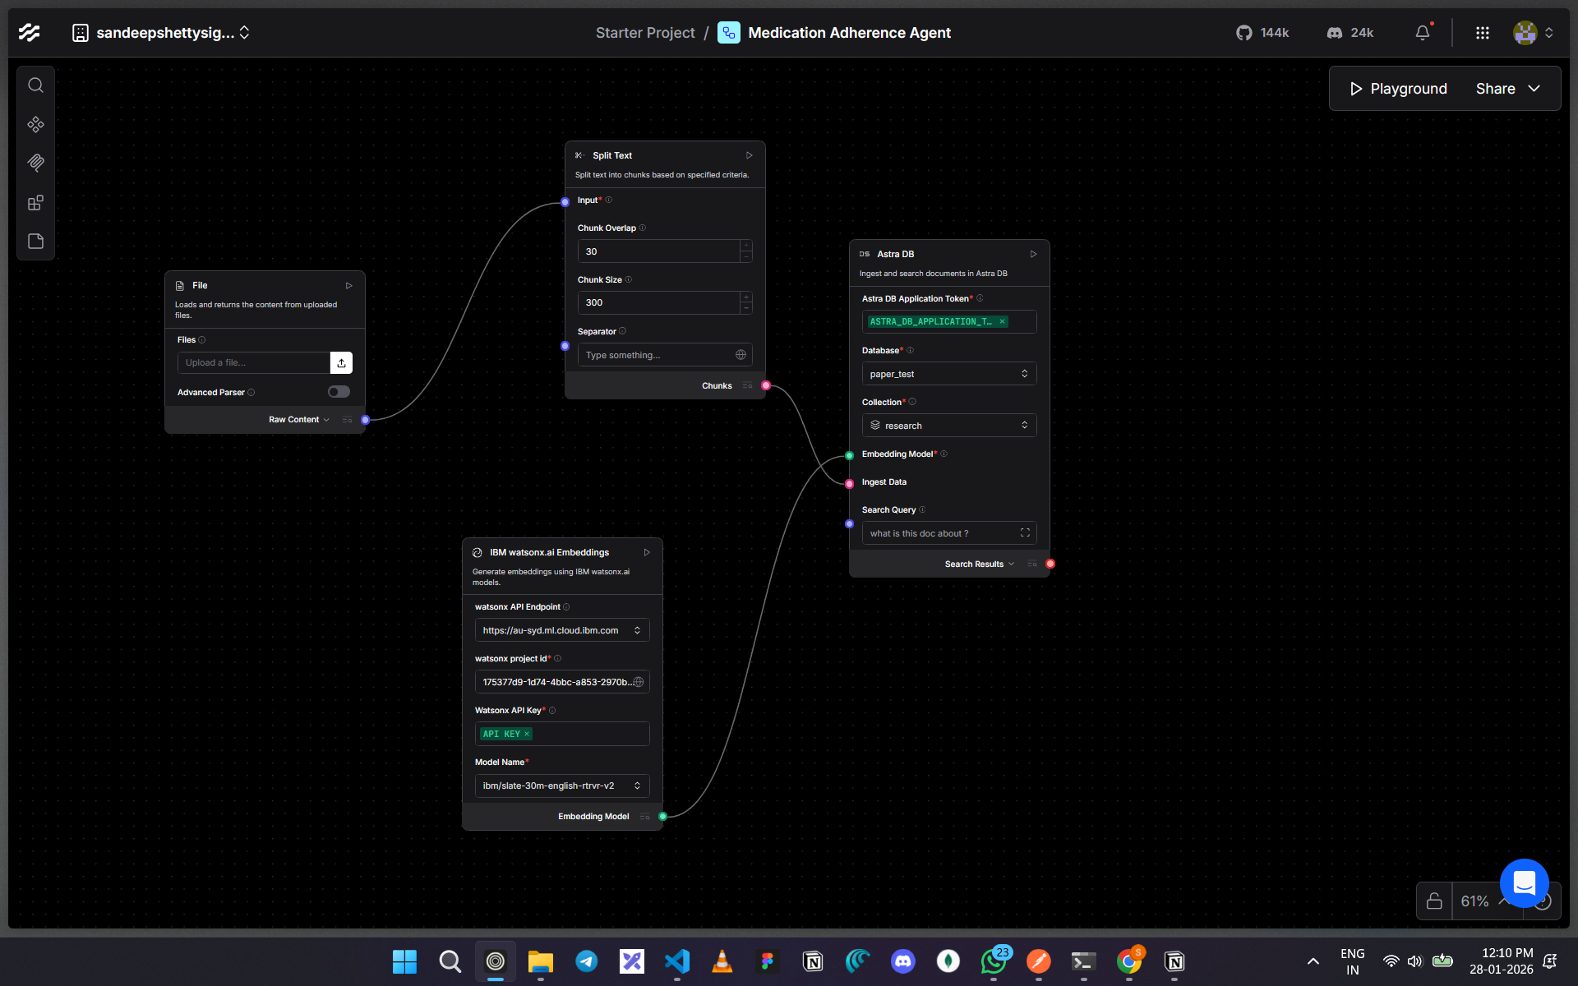
File Uploading for vector Embeddings

Slide 15
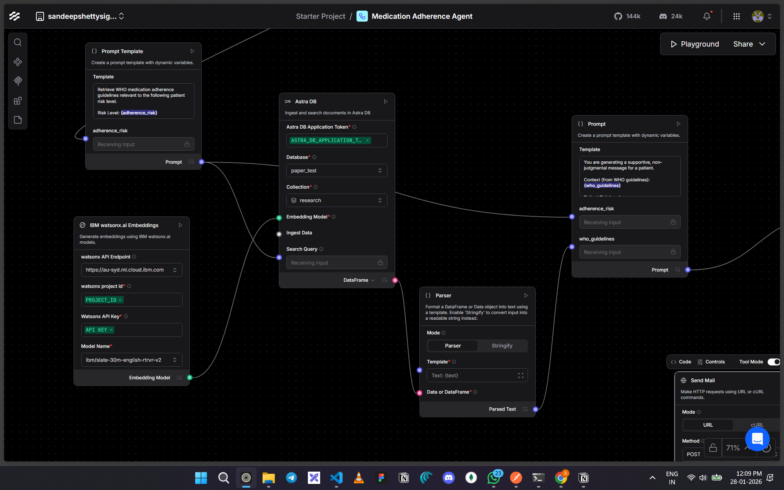
Output Screenshot 1

Slide 16
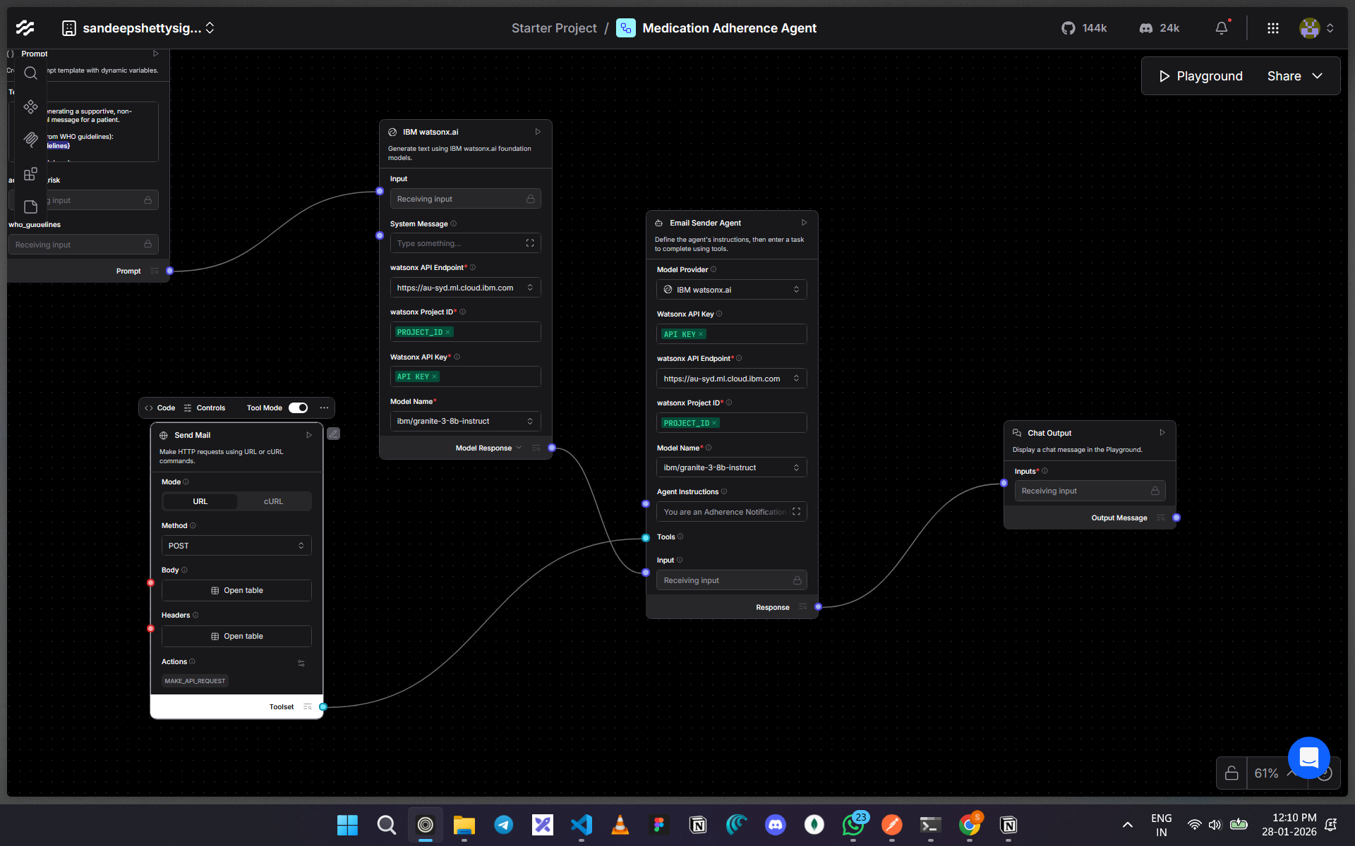
Output Screenshot 2

Slide 17
Core pillars of Innovation and Research Grounding
1. Group-Based Trajectory Modeling (GBTM) Logic
The Science: Grounded in the landmark Nagin & Odgers (2010) and Franklin (2013) research.
The Application: Our Risk Detection Agent identifies transition points where a patient moves from "Consistently Adherent" to "Slow Decline" groups, allowing for intervention before a dose is missed.
2. Mathematical Rigor: PDC & MPR Metrics
            Standardized Analysis: The Data Analysis Agent uses the clinical standard Proportion of Days Covered (PDC) formula to provide quantitative validity to the adherence scores.
                PDC = Total days medication was on hand / Total days in the period
3. Safety & Ethics via Granite Guardian 3.0
Hallucination Protection: Every generated email and advisory is passed through Granite Guardian 3.0 to ensure 100% "Answer Faithfulness" against the medical knowledge base.
Regulatory Compliance: Built with Privacy-by-Design to ensure patient health data is handled safely, following non-diagnostic, "assistive-only" healthcare standards.
4. Behavioral Science: Nudge Theory & Habit Linking
Personalized Psychology: Grounded in Behavioral Tailoring research, the Advisory Assistant doesn't send generic alerts; it suggests "habit-linking" techniques (e.g., "Take your dose with your morning tea") proven to form long-term adherence.
5. Multi-Agent Orchestration Synergy
Beyond Linear RAG: Unlike traditional RAG, our Langflow architecture uses Agentic Reasoning (ReACT Prompting), where agents collaboratively decide when to use specific tools (Calculators vs. Search vs. Email) to solve the patient's goal.

Slide 18
Future Scope
SMS / WhatsApp notifications
Doctor & caregiver alerts
Adaptive reminder scheduling
Integration with hospital EMR systems
Feedback-based reminder optimization

Slide 19
Git Hub Link
https://github.com/sandeep5shetty/langflow-medication-agent

Slide 20
References
WHO — Adherence to Long‑Term Therapies: Evidence for Action
This is a foundational WHO report defining and explaining medication adherence and its global impact. WHO Adherence to Long‑Term Therapies: Evidence for Action
NICE Guideline CG76 — Medicines Adherence
UK clinical guideline on involving patients in decisions about medicines and supporting adherence. NICE Medicines Adherence Guideline CG76
NICE Surveillance Summary
Describes the continued relevance of the CG76 guideline and mentions digital tech/decision support. 2019 NICE Guideline Surveillance on Medication Adherence

Slide 21


